Slide 1



Looking Backward, Looking Forward
PTDM @ ICDM
Pieter Adriaans
Universiteit van Amsterdam

Slide 2




Slide 3

Looking backward 1985-2012 More than 200 AI,ML,DM projects
AI, Expert Systems, Prolog Data Base technology
(OBIS 1988, Captains, 1992)
Data Mining: Workstation, Client Server, Mature ML research, large data bases
Time dimension (ASM, ICT)
Structured Data (GI, EMILE)
Dynamic Systems (JSF, Robosail)
E-science (Vl-e)
Big Data (Commit, Data2Semantics)

Slide 4

Looking forward
Complexity measures: facticity
Empirical incompleteness theories
e-science methodology for the 21st century

Slide 5
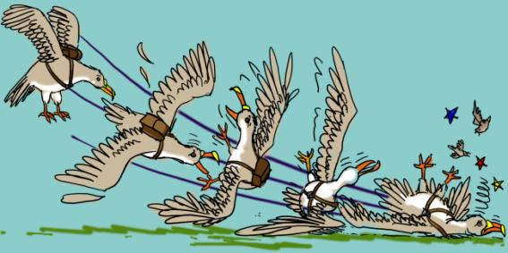
1992: Captains
Crew Availability planning KLM
Oracle Database
Prolog planning algorithms
Genetic Algorithms for Bid Prediction

Slide 6
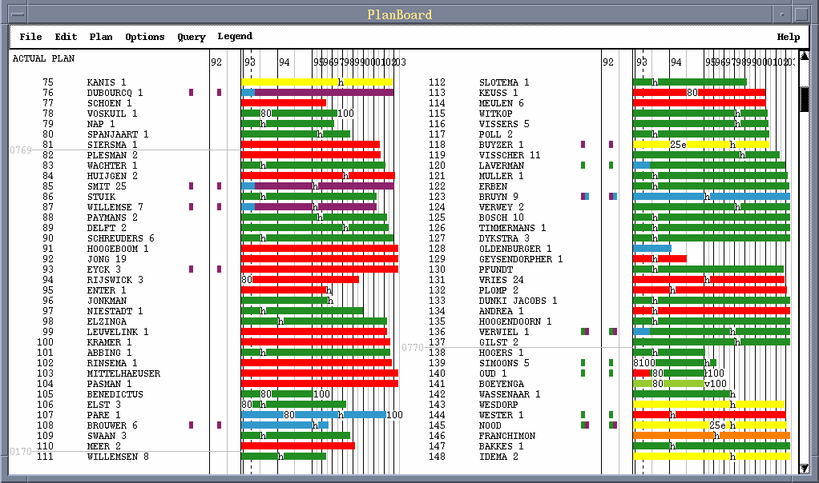

Plan board
Seniority
Transitions
Horizontal/Vertical binding
Pilot bids (preferences)
Part Time

Slide 7
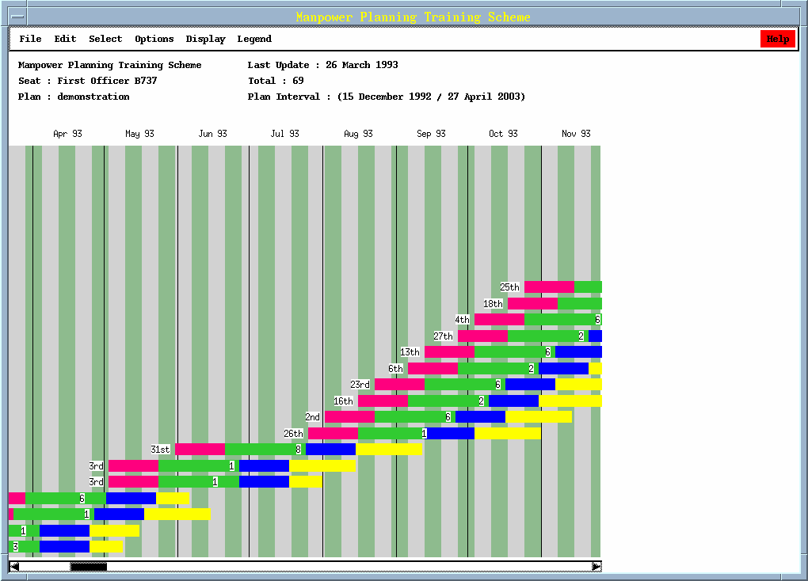
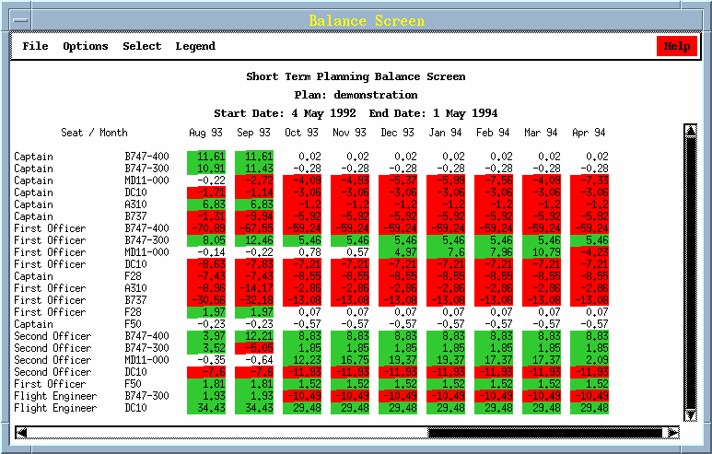
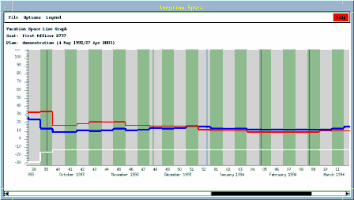
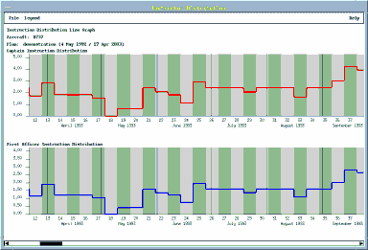
Manpower planning
Manpower Planning
Seat Survey
Vacation Distribution
Instruction Distribution

Slide 8

1996

Slide 9
The ancestors of Data Mining
Database
Query languages
4 Generation languages
Executive Information System
OLAP
Data Mining
Next hype (?!)

Slide 10
KDD Definition
Knowledge Discovery in Databases is the non trivial extraction of implicit, previously unknown and potentially useful knowledge from data (after Frawley Et al. 1991)

Slide 11
The KDD process
Data
selection
Cleaning
Domain consistency
De-duplication
Disambiguation
Enrichment
Coding
Data Mining
Clustering
Segmentation
Prediction
Reporting &
application
Information
requirements
Action
external
data
Feedback

Slide 12
1997: Adaptive System Management
the use of machine learning and data mining techniques to create self-learning models of the constantly changing IT-environment that allow us to predict the behavior of systems in the future and take timely automated remedial action to prevent system failure or decreased availability of the system.

Slide 13
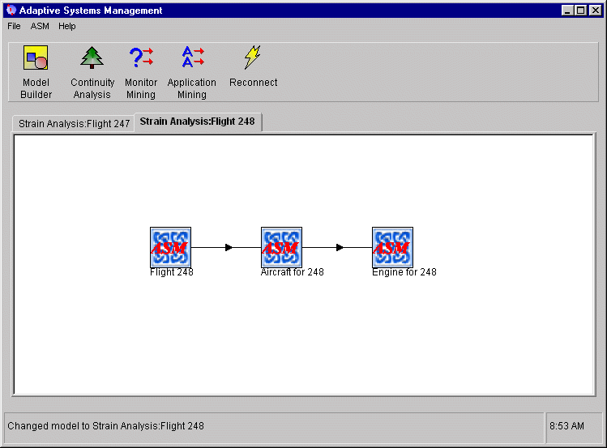
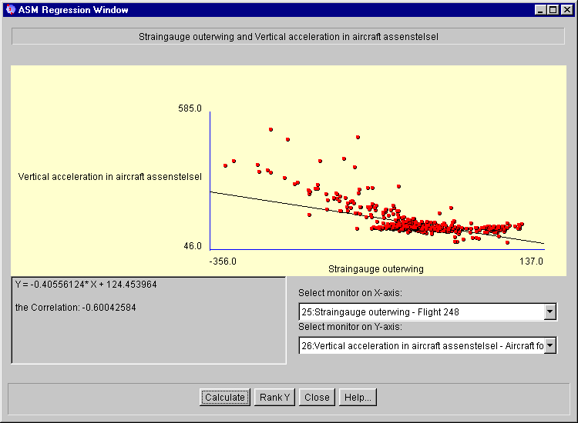
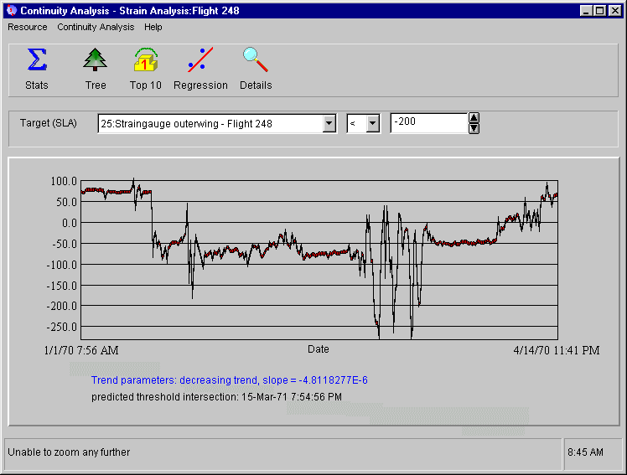
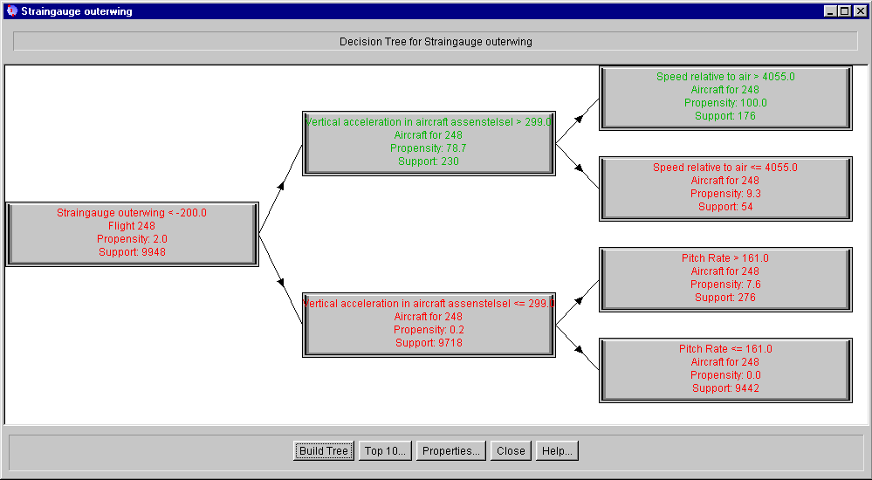
Applications
Analysis of IT infrastructures using knowledge discovery

Slide 14
Monitoring in the system
Distributed
System
Monitors
D
C
Service
Level
Agreement
B
E
A
A
B
C
…
Time 1
15
4
13
…
Time 2
12
2
16
Time 3
17
8
8
Time 4
22
12
17
Monitor Legend
…
…
…
…
A: Nr. of Processes
B: Nr. of Failed Jobs
C: Login time Application
D: System Load
E: CPU Idle time
etc.
Time k

Slide 15
Refining thresholds
Refining thresholds through
Machine Learning
B
C
A
Historical Data
B
A > 20
C > 15
B > 10
Learning Thresholds
C
Learned Model
A

Slide 16
Prediction of failure
Prediction of failure from
Extrapolated Measurements
Support
Effort
Time
40
A > 20
C > 15
B > 10
30
Monitor
Values
A
20
C
A
B
10
C
B
0
Time
Now
Predicted
Failure

Slide 17
Patents
Adriaans et al. United States Patent US 6,311,175 B1 System and method for generating performance models of complex information technology systems.
Adriaans et al. United States Patent US 6,313,390 B1 A method for automatically controlling electronic musical devices by means of real-time construction and search of a multi-level data structure.
Adriaans et al Unites States Patent US 6,393,387 B1 System and method for model mining complex information management systems.

Slide 18
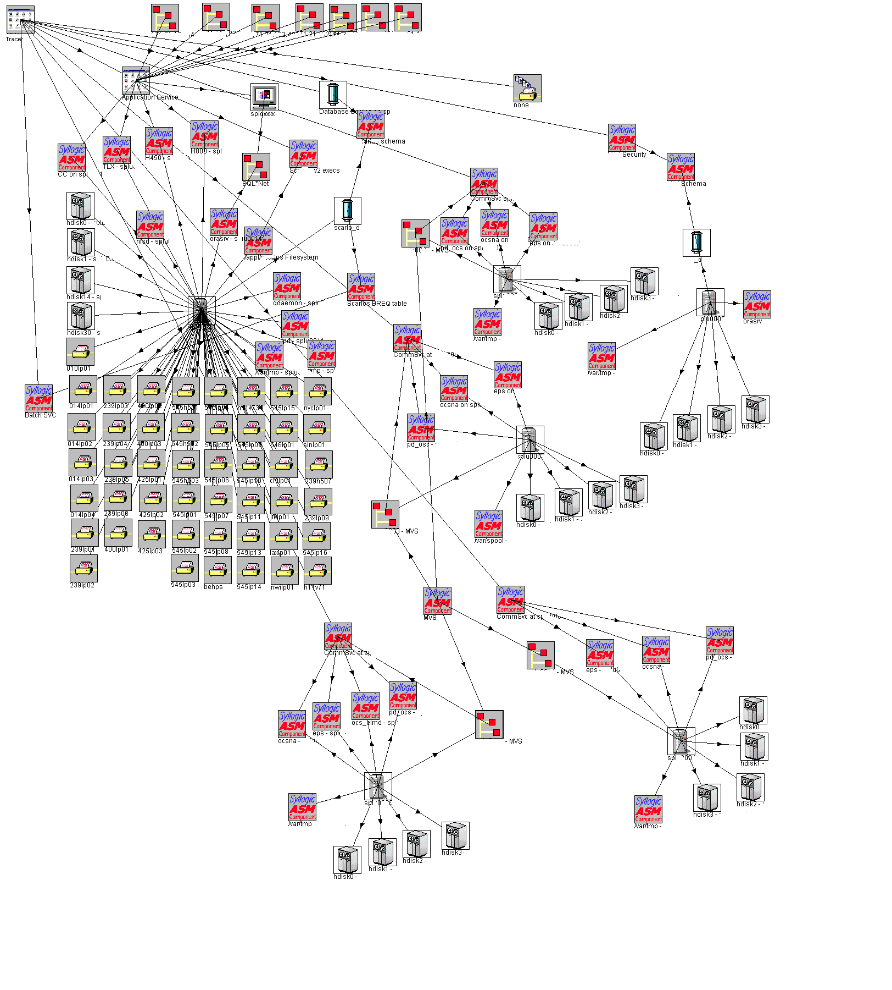
Experiments
140 components
250 monitors
2 months
3500 snapshots

Slide 19
Helpdesk calls application

Slide 20
Decision tree Scarlos performance
CPU Idle SPL11 % > 63
Paging Space used SPL11 > 685
381
35%
1229
76%
CPU Idle SPL11% <= 63
Test Query > 3
848
94%
3749
42%
Paging Space used SPL11 <= 685
2520
25%
Notes:
23
21

Slide 21
Paging space develops polynomially

Slide 22
CPU Idle Trend

Slide 23
1998-2005

Slide 24


Slide 25
Pole Balancing
State:
Velocity of the cart
Position of the cart
Position of the stick
Velocity of the stick
Action:
Force on cart
Reward:
Stability of the pole

Slide 26
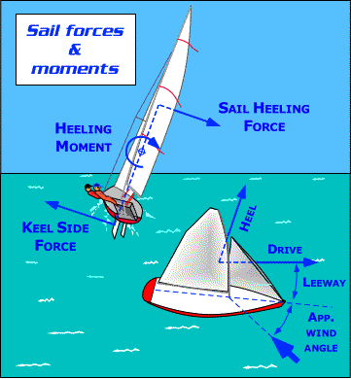
Ship Balancing
State:
Velocity of the rudder
Position of the rudder
Course
Log speed
Apparent Wind speed
Apparent wind angle
Heel
etc...
Action:
Force Excercised on the rudder
Reward:
Velocity of the yacht

Slide 27
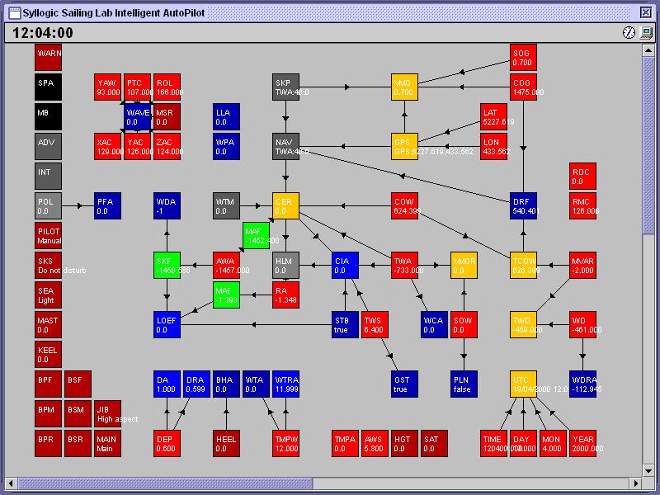

Slide 28
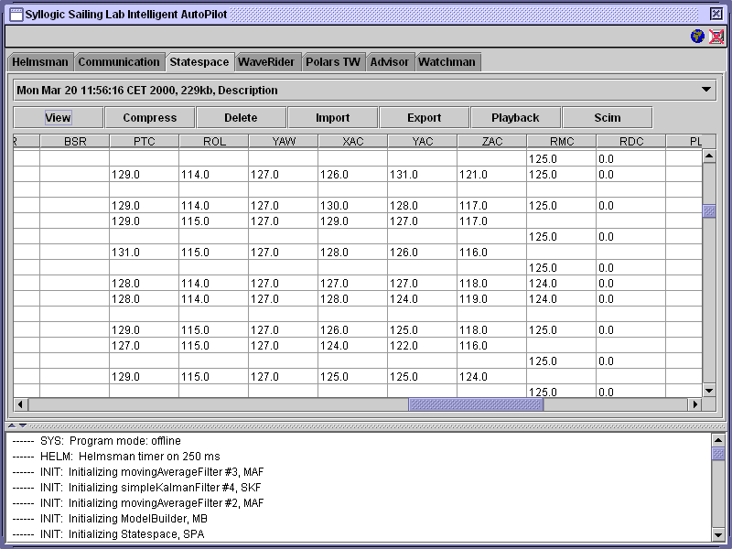

Slide 29
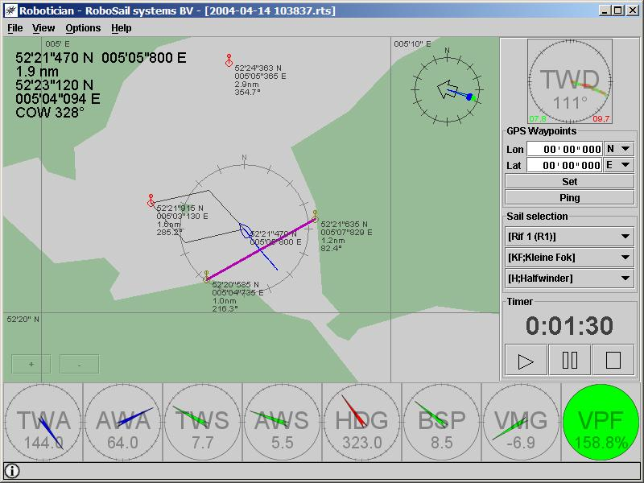

Slide 30
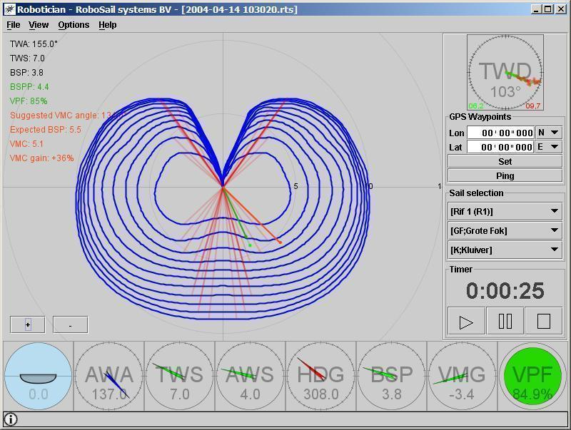

Slide 31
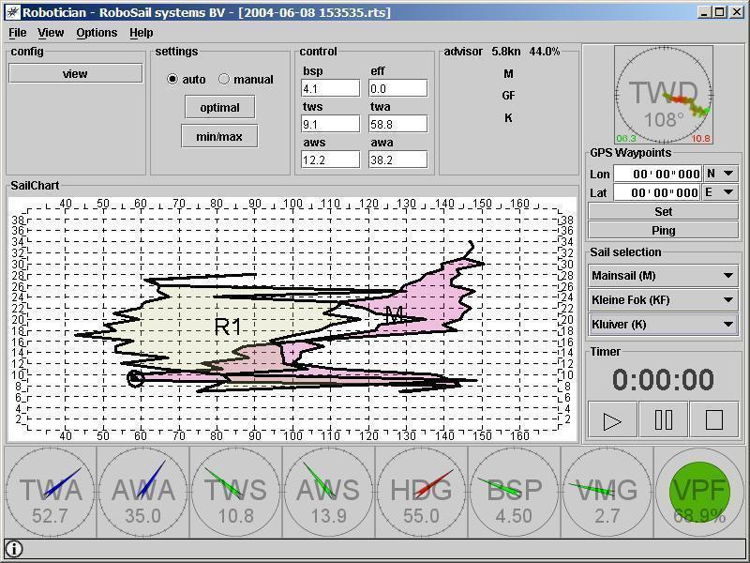

Slide 32
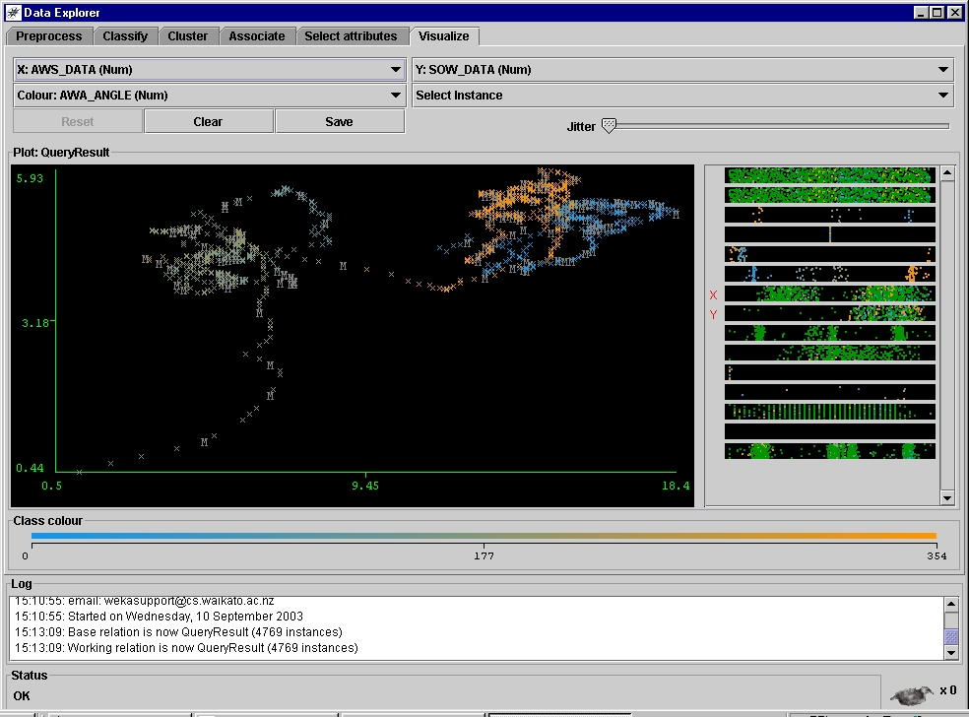
Mining for Sensor Calibration

Slide 33
Mining for Sensor Calibration
Possible causes:
Log sensor gives asymmetric data
Wind sensor gives asymmetric data
Boat itself is asymmetric
Boats with masts > 25 m perform better over port-bow on Northern hemisphere

Slide 34
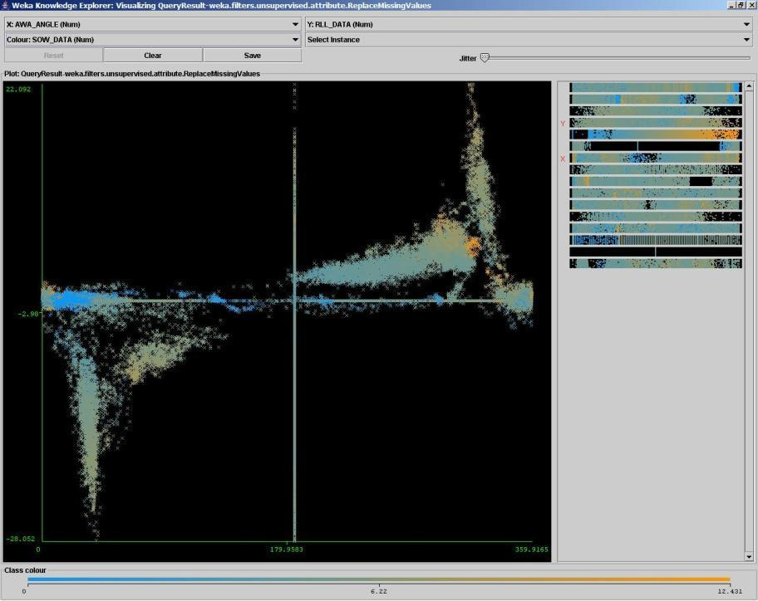

Slide 35
2003-2009 Adaptive Information Disclosure (AID) participating in the VL-e (Virtual lav for e-Science) project

Slide 36
Adaptive Information Disclosure
Data
Selection
Preprocessing
Named
Entity
Recognition
Relation
Recognition
Advanced
Constraint
Recognition
Validation
Version
Manage-
Ment
Domain
selection
Ontology
Knowledge Extraction
Information Retrieval
Formulate
query
Fire
query
Search
Construct
answer
Display
results
User support:
Alternatives
Disambiguation
Query
Expansion
Filtering
Relevance-
score
Link to
Concept tree

Slide 37
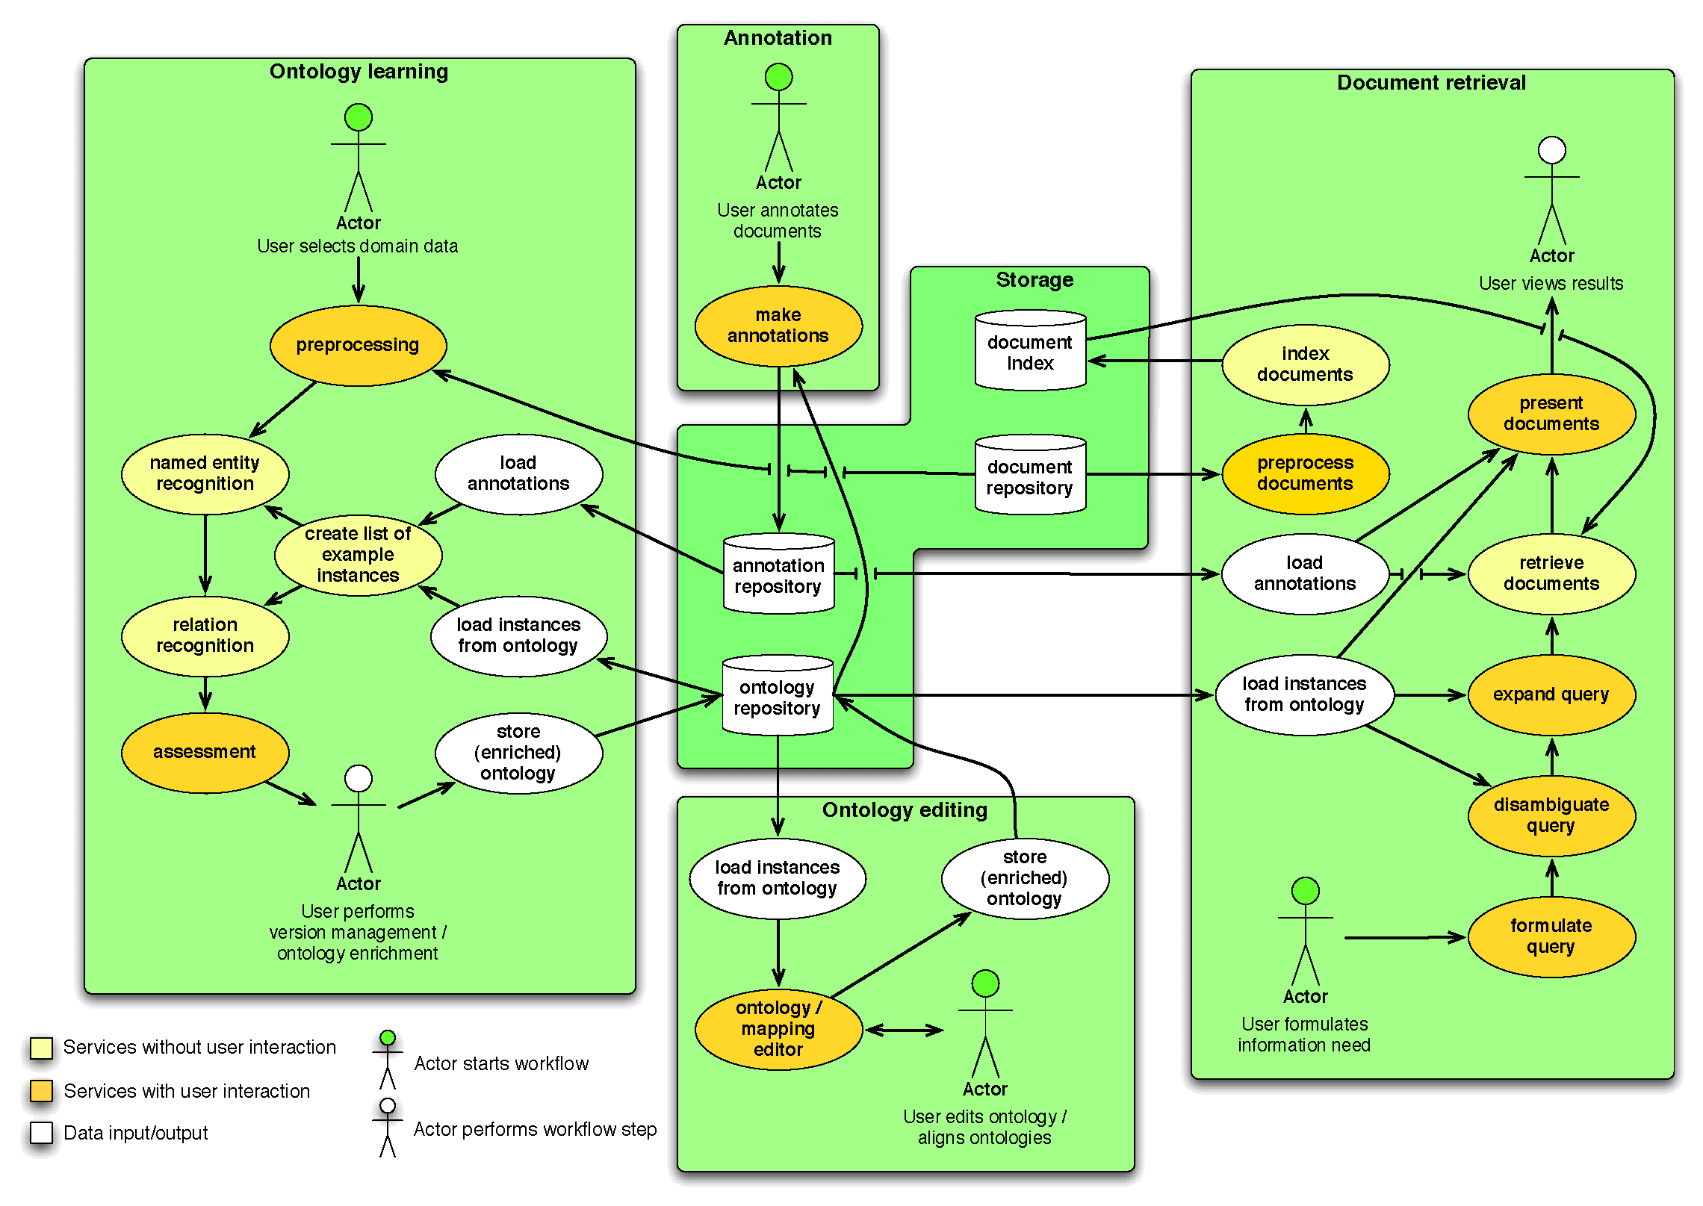
The AIDA toolbox for knowledge extraction and knowledge management in a Virtual Laboratory for e-Science
Notes:
Each set of components in the AIDA Toolbox is developed by a different expert in information retrieval, machine learning, and Semantic web. The motivating idea is that applications can be built by expert users such as bioinformaticians and food informaticians. Multidisciplinary collaboration is another important aspect of e-science.

Slide 38





2010-2015: D2S: From Data to Semantics for data publishers
Challenges
How to share scientific data?
How to access, analyse and interpret the data?
How to communicate and publish results?
Domains
Life-Sciences
Humanities
End Users
Elsevier
Philips
DANS

Slide 39


How do we speed up the transfer of scientific data, information, knowledge from a research paper into actionable form?
Looking to become a provider of clinical rules
Map clinical guidelines against recent papers
Link to data sets of research paper
looking to quickly consume research findings into Clinical Decision Support systems
current guideline update cycle is 5 years

Slide 40
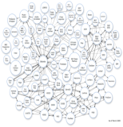

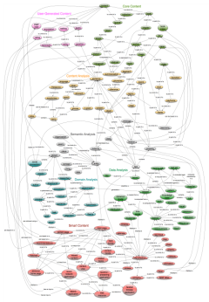
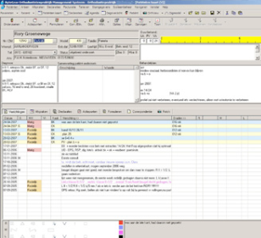


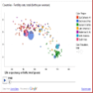
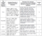





Smart content at Elsevier
& Philips
Smart Content Applications
Better discovery through semantic search & navigation
Faceted search & browse
Ontology-driven navigation
Task-specific results
Personalized/localized results
Question answering
Linked data from partners and the Web
Text
Better understanding through analysis and visualization
Tag clouds
Heatmaps
Streamgraphs
Scatterplots
Time series
Animations
Entities, concepts and relation-ships
Elsevier content
Tables
Images
New knowledge through aggregation and synthesis
Topic pages
Social network maps
Geolocation maps
Data mashups
Text mining reports
Philips Hospital Information System
Elsevier
knowledge organization systems

Slide 41

Looking Forward

Slide 42
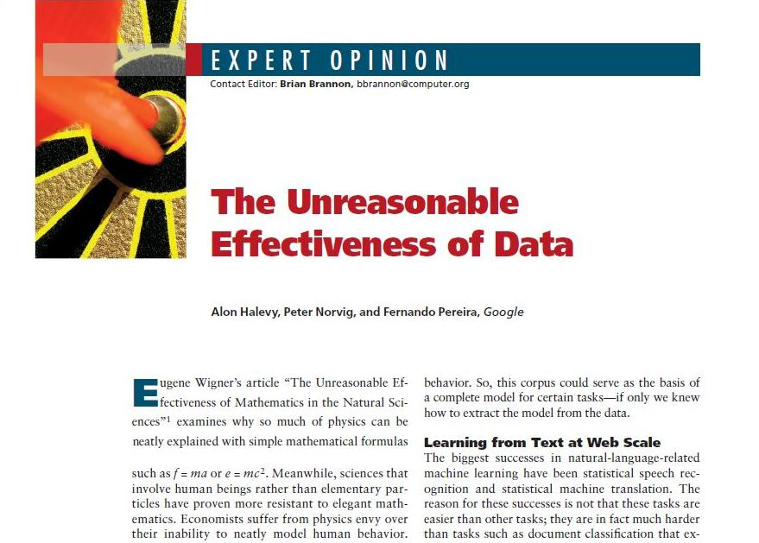

Slide 43
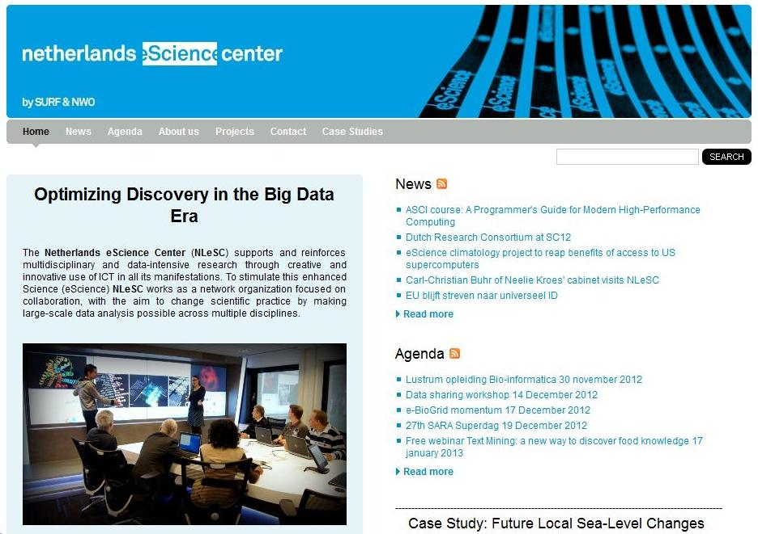

Slide 44

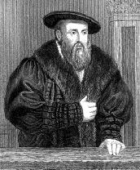
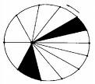

Research cycle
System
Observations
Processing
model

Slide 45
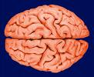
Research cycle
System
Observations
Processing
model

Slide 46
Science in the 21st century
Size and complexity of problems
Climate studies,
Human cognition,
The Cell
Elementary structure of matter,
Language
Social networks

Slide 47
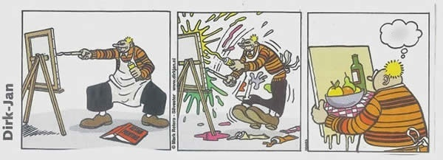
Research objective facticity project
Formulate a mathematical theory about an objective measurement of the amount of model information in a data set

Slide 48




25 % noise
50 % noise
75 % noise
100 % noise

Slide 49






Slide 50
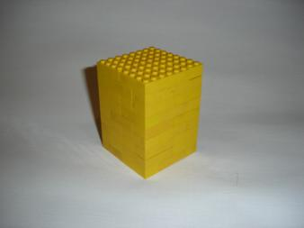
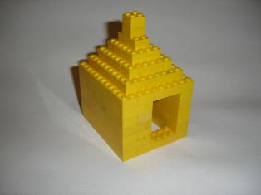
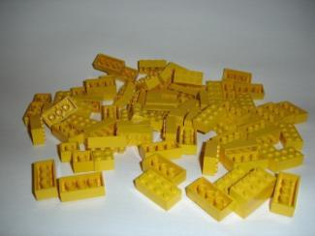
Between order and chaos: facticity
Order
Facticity
Chaos

Slide 51
Facticity (Questions)
Is there a universal model extraction method? (yes)
Are there possibly more optimal models? (yes)
Can we be sure that it is“definite”” i.e. all relevant model information is extracted and nothing more (tricky, but yes)
Is facticity stable? (No, but more a feature then a bug)

Slide 52
Turing two-part code compression
data
11
0
n
i
p

Slide 53
Definition of facticity: the amount of self-descriptive information in a dataset
The facticity φ(x) of a string x is the amount of self descriptive information in x.
Facticity is definite!
11
0
n
i
p
facticity
Residual entropy

Slide 54
Crash Course Complexity Theory
Total Data set
Optimal non-loss
Compression
Optimal
lossy compression
Model
Infor-
mation
Residual
entropy
Randomness deficiency

Slide 55
existing complexity measures
entropy estimators: (Shannon, Kolmogorov, VC-dimension)
model complexity estimators (sophistication, computational depth, self-dissimilarity, facticity),
network-analysis measures (structural graph-theoretic properties, centrality, betweennes, degree distributions)
complex systems analysis (multi-scale analyses, robustness, dynamics)
and their theoretical connections.

Slide 56
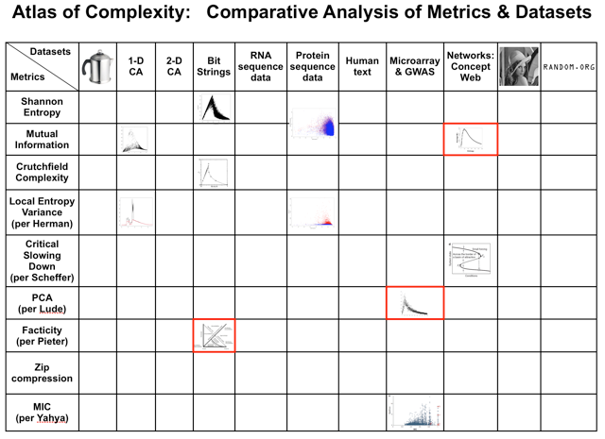

Slide 57


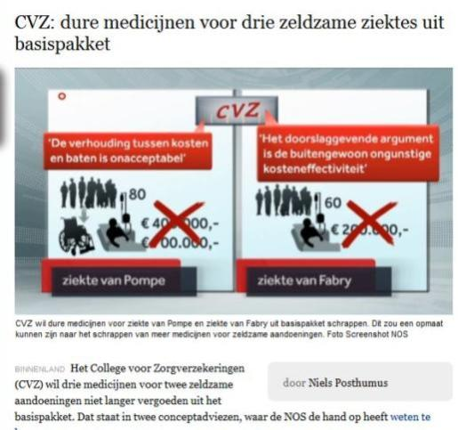
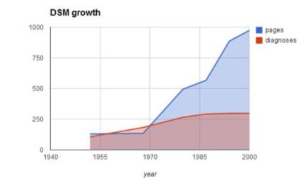

Slide 58
Research Questions
What is a medically relevant model of an individual human being?
How complex is such a model?
How individual is such a model?
How difficult is it to learn or make such a model?

Slide 59
medically relevant model of an individual human being
A computational model (or program) that allows us to predict, explain (and if possible, help cure) any disease an individual human being X could have or get.

Slide 60
Research cycle
System
Observations
Processing
model

Slide 61
Research Methodology Proposal I
Make a list of all possible diseases.
For every disease study a relevant group of patients empirically and make a model that allows us to make deterministic predictions.
How much diseases are there?
2000?
7000?

Slide 62
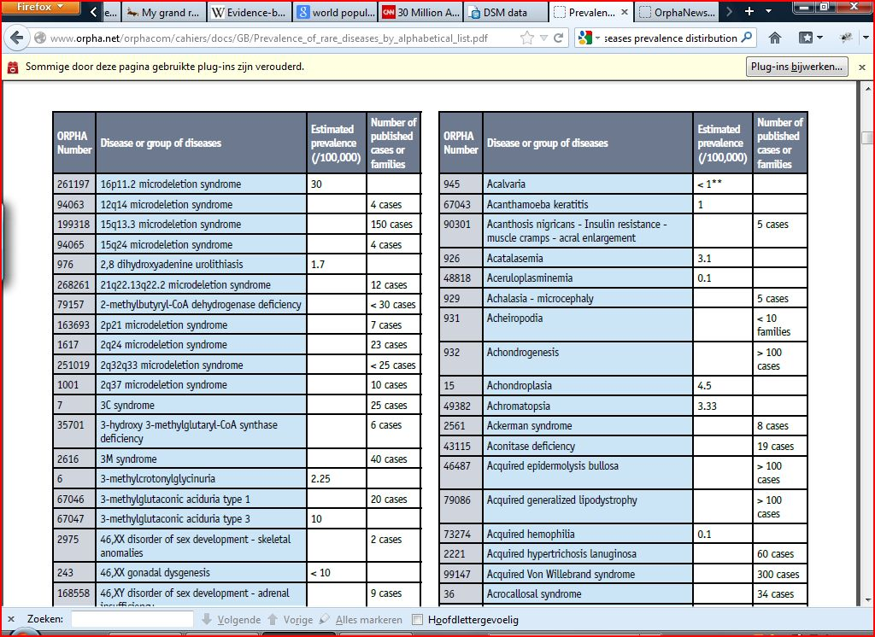


Slide 63
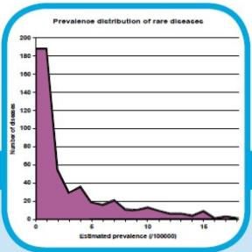
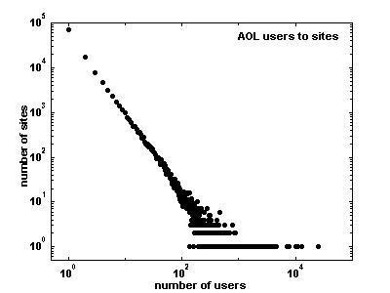
Powerlaws
Log y
log_{c} y = -a log_{c} x + b
y = c^{b}x-ª
Log x

Slide 64
Problems!
Power laws have no mean (i.e. it is infinite)
If you double the population, you not only double the number of patients, but also the number of diseases.
There is a (seemingly) unlimited supply of rare diseases.
Most possible diseases are so rare that we never see them!

Slide 65
Research Methodology Proposal II
Forget the list of all possible diseases.
Forget deterministic prediction.
Just study a relevant group of patients that is large enough to make statistically relevant risk assessments.
How big a group of patients?

Slide 66
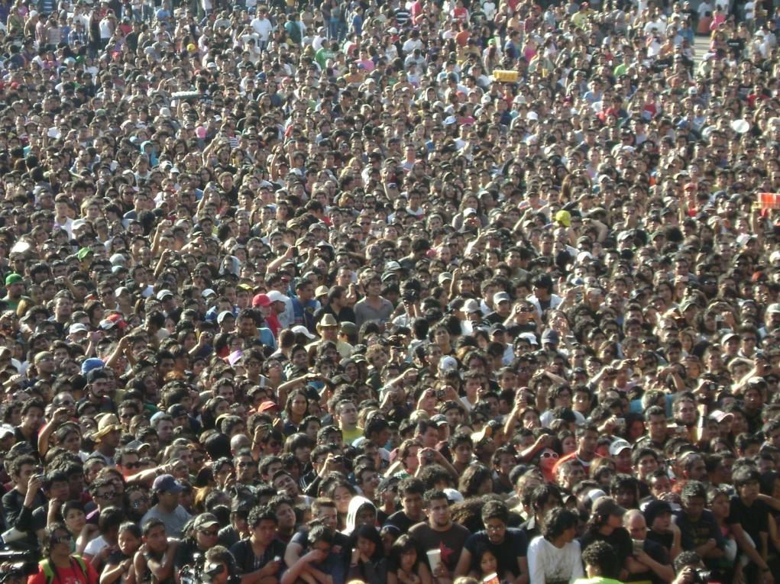
Learning Algorithm
Trainingset
Model
Testset

Slide 67
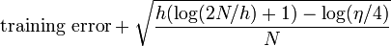
VC dimension
The bound on the test error of a classification model:
Probability
Size of training set N
VC dimension: h
Condition: h << N

Slide 68
Problems again!!
Size of training set N
VC dimension: h
Condition: h << N
Maximal: current world population = 0.7 x 10^10
Maximal size of the medically relevant model of an individual human being
10^8 bits ≈ 12,5 Mb

Slide 69
12,5Mb!!
Maximal size of the medically relevant statistical model of an individual human being.

Slide 70

Information: Some numbers
10^10 bits Human genetic code
10^14 bits Human brain
10^32 bits Human body at quantum level (10^28 electrons)
10^92 bits Total Universe
10^123 Total number of computational steps since Big Bang (Seth Lloyd)

Slide 71
Empirical Incompleteness theory
Our universe contains classes of entities that have a population size that is much smaller then their relevant model complexity measured in bits.
No adequate statistical models of such classes of entities based on frequency observations can be constructed.

Slide 72
Research cycle
System
Observations
Processing
model

Slide 73
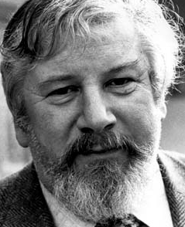


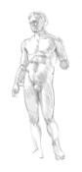
Mutual model information The classical view
Ideal
Faults
Iideal
Faults
Same model

Slide 74
Crash Course Complexity Theory
Total Data set
Optimal non-loss
Compression
Optimal
lossy compression
Model
Infor-
mation
Residual
entropy
Randomness deficiency

Slide 75
mutual model information? Computational View
?

Slide 76
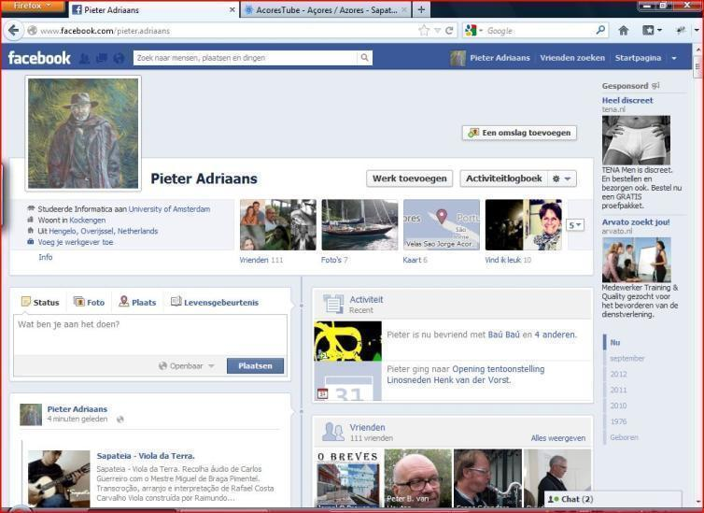
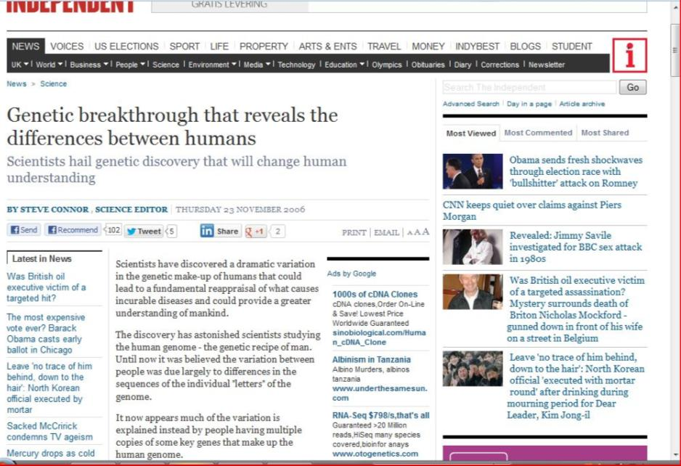
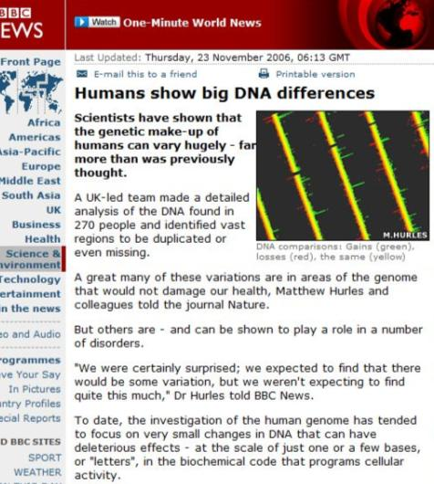
Any two unrelated human beings differ by about 3 million distinct DNA variants.
+ Complete
Personal
History

Slide 77

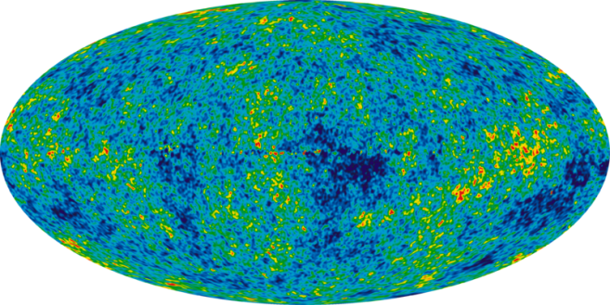
Loading model
In to memory takes the amount of energy stored in a fully fueld Boeing 747-400
Individual model on
quantum level
Simple quadratic
search takes the total amount of energy in the known universe

Slide 78
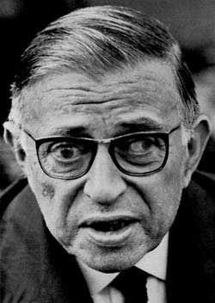
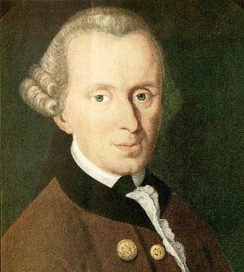




Breaking a long tradition

Slide 79

Conclusions
Data mining is developing in to the study of Big Data and e-Science
We need to rethink scientific methodology for the 21st century.
Our universe contains classes of entities that have a population size that is much smaller then their relevant model complexity measured in bits.
The individual is the species!
Consequences for:
Political organization of society
Ethics and human rights
Scientific Methodology
Medical policies (Caritas versus evidence based medicine)

